Slide 1
SOP for merging CSV output from Metaboanalyst to results Excel sheet

Slide 2
Prepare *.csv files

Slide 3

A. Open the binary comparison csv that provided and check
All the CSV files will be provided to you in the project folder. You may also consider making the one from normalized data file. Decode the sample from randomized sample list in the normalized data file, remove pooled QC samples and make csv files for the two groups need to be compared for that particular binary comparison.

Slide 4
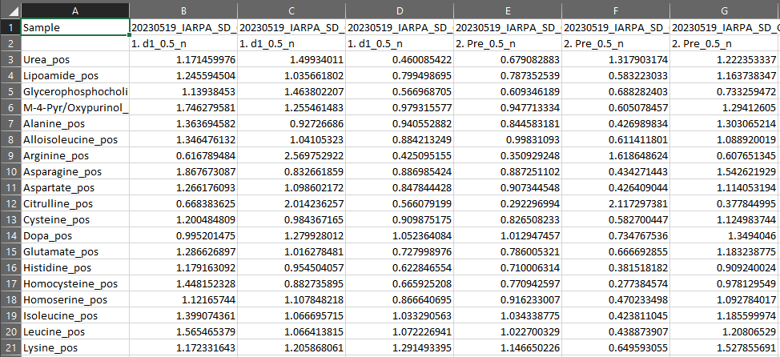
B. Check the *.csv file and make sure that group information was correct on the second row.

Slide 5
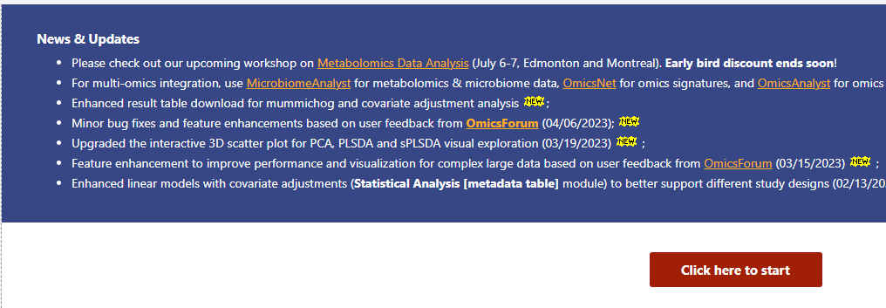
C. Go to website: https://www.metaboanalyst.ca/
And click “Start”

Slide 6
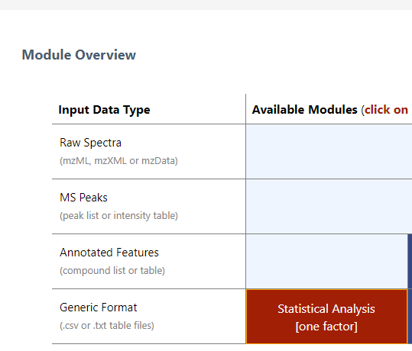
D. Choose Statistical Analysis [one factor]

Slide 7
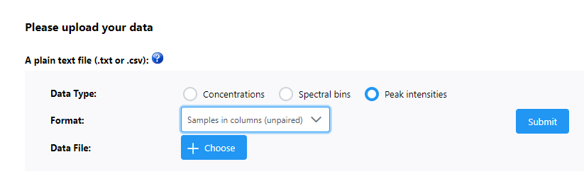
E. Upload the csv file provide using “A plain text file data type peak intensities samples in columns (unpaired), then choose the csv file and click Submit

Slide 8
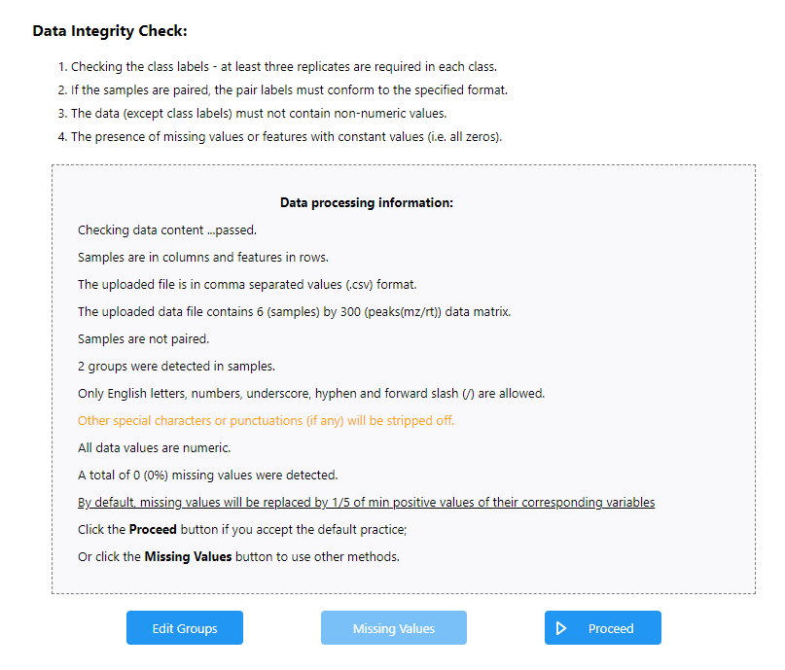
F. Check the data and proceed

Slide 9
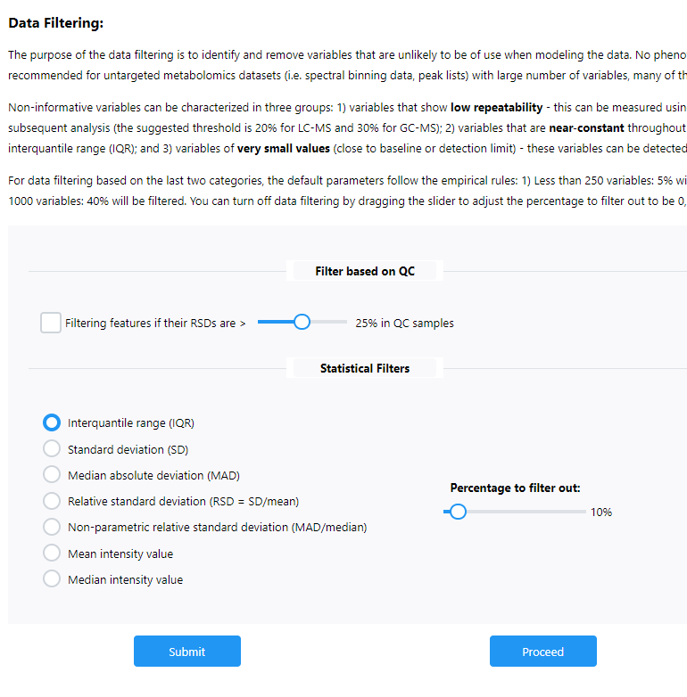
G. Proceed for Data filtering, most cases, data are already filtered based on QC-RSD, so no more filtering needed

Slide 10
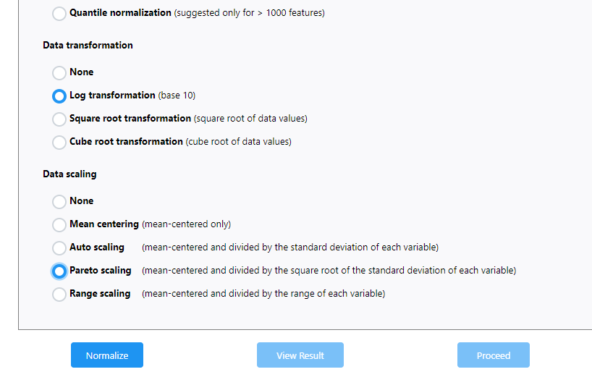
H. Log transformation and pareto scaling and then click Normalize then proceed

Slide 11
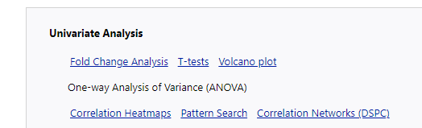
I. Click on T-tests

Slide 12
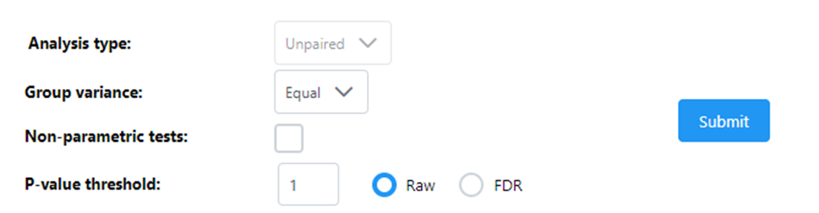
J. Set the threshold to 1 and choose raw to keep all features

Slide 13
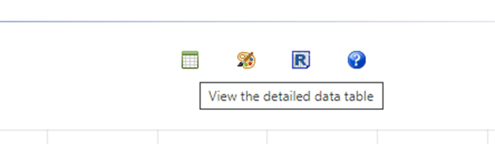
K. Click on the view the detailed data table to see the details

Slide 14
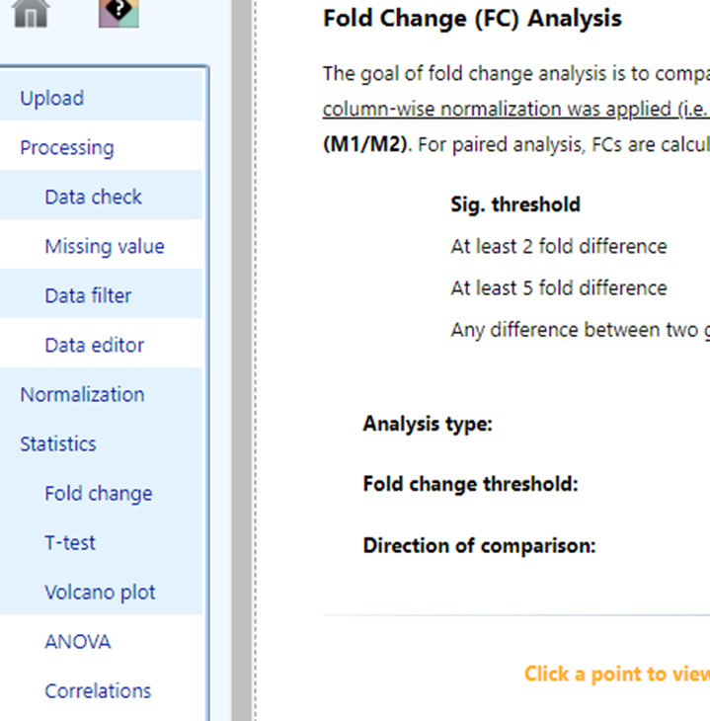
L. Similarly, you can also calculate the fold change, plot volcano plot, PCA plot, and other plots.

Slide 15
SOP for merging CSV output from Metaboanalyst to results Excel sheet

Slide 16
A. Sort each result table by the feature ID (metabolites or lipids)

Slide 17
B. Make sure all result features are in the same order and then copy and paste them into one excel file.

Slide 18
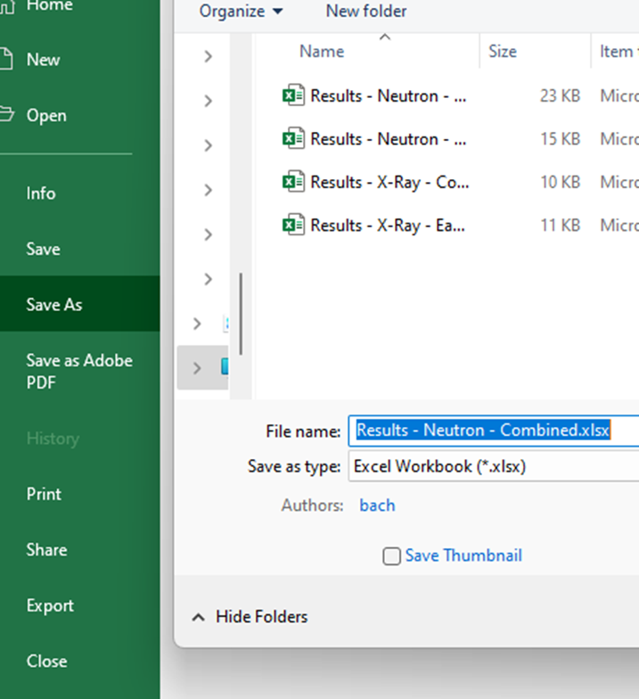
C. File -> Save As (.xlsx)

Slide 19
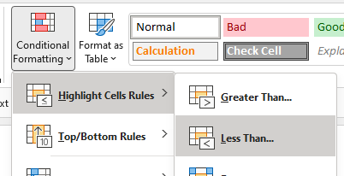
D. Select p-value columns and choose Styles -> Conditional Formatting -> Highlight Cells Rules -> Less Than 0.05

Slide 20
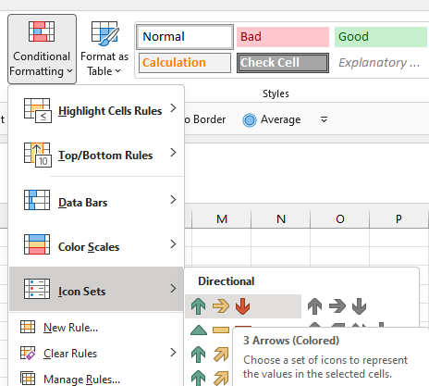
E. Select log2(FC) columns and choose Styles -> Icon Sets -> Directional -> Arrows

